Slide 1
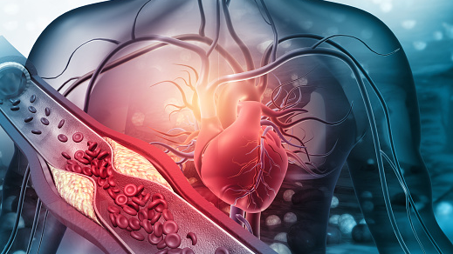

Ways of combating non-communicable diseases in Sri Lanka
By MLB_10.2_02

Slide 2
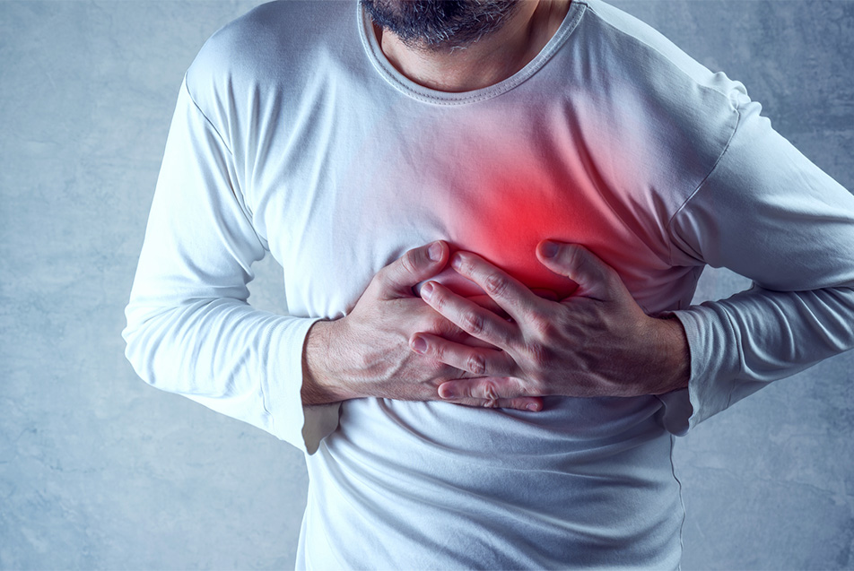
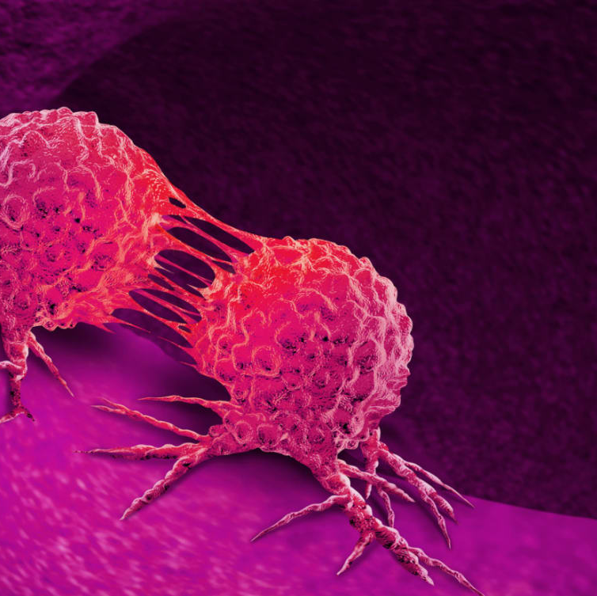
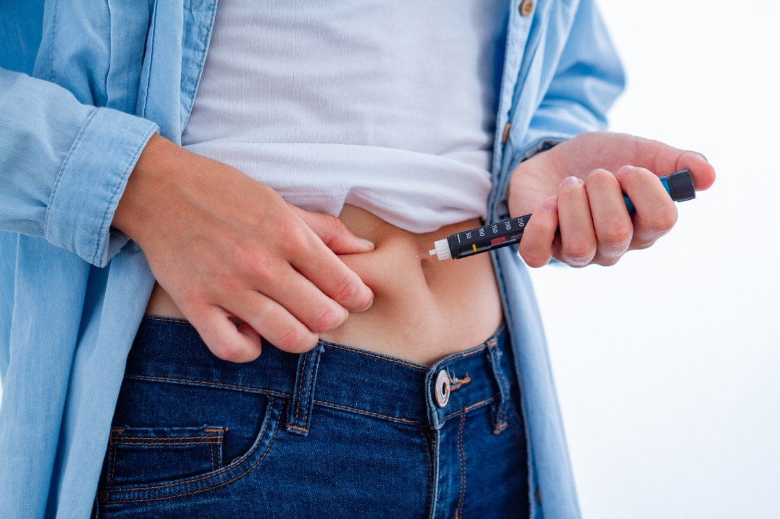
Content
01
Non – communicable Diseases (NCDs)
Common Reasons for NCDs
Psychological Effect of NCDs
Ways of fight against NCDs
Government actions to fight against non-communicable diseases in Sri Lanka
Conclusion
02
03
04
05
06

Slide 3
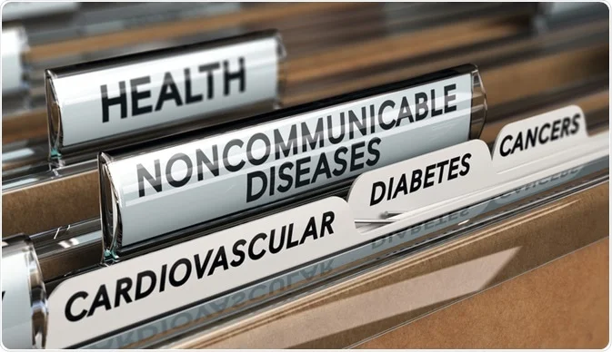
Introduction
Today’s people are very busy with their lifestyle. So , they do not have time to take care of their health.
As a result of this, Non – Communicable diseases are spreading in all over the world.

Slide 4

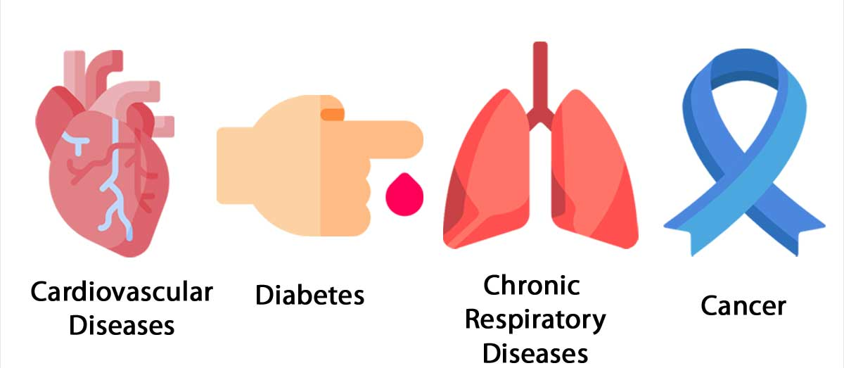
1. Non – communicable Diseases (NCDs)
Madusanka G.K.I (IT21189944)

Slide 5
Non - Communicable Diseases ( Chronic Diseases)
Long-term illnesses caused by a mix of
Genetic
Physiological
Environmental
Behavioral factors.
Diabetics
Cancer
Heart Diseases
High Blood Pressure
Madusanka G.K.I (IT21189944)
5

Slide 6
Noncommunicable diseases (NCDs) claim the lives of 41 million people each year.
71% from all deaths worldwide including more than 15million people between 30 – 69 ages. (WHO)
NCDs infect people with all ages, all area, all countries.
Madusanka G.K.I (IT21189944)
6

Slide 7
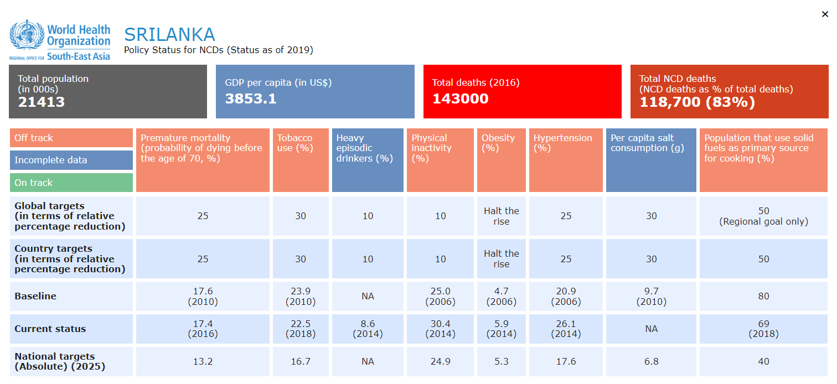
non-communicable diseases (NCD’s) are cause majority of deaths is Sri Lanka which is over 80%.
Madusanka G.K.I (IT21189944)
7

Slide 8
1 . Diabetics
Diabetes is a chronic (long-lasting) health condition that affects how your body turns food into energy.
Diabetics patients can’t produce enough insulin.
Diabetics patients must get insulin injections.
Madusanka G.K.I (IT21189944)
8

Slide 9
Obesity and physical inactivity are major contributors to the rising diabetic population.
Diabetes is also becoming more common in Sri Lanka.
Diabetic Patients Deaths in Sri Lanka reached 12,399 in 2018, accounting for 9.75% of all deaths (WHO).
Sri Lanka is ranked 35 in the world with an age adjusted death rate of 53.41.
Madusanka G.K.I (IT21189944)
9

Slide 10
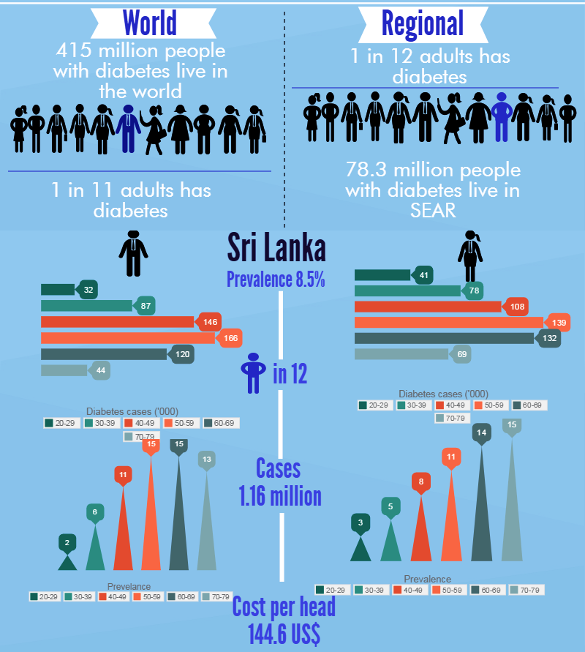
10

Slide 11
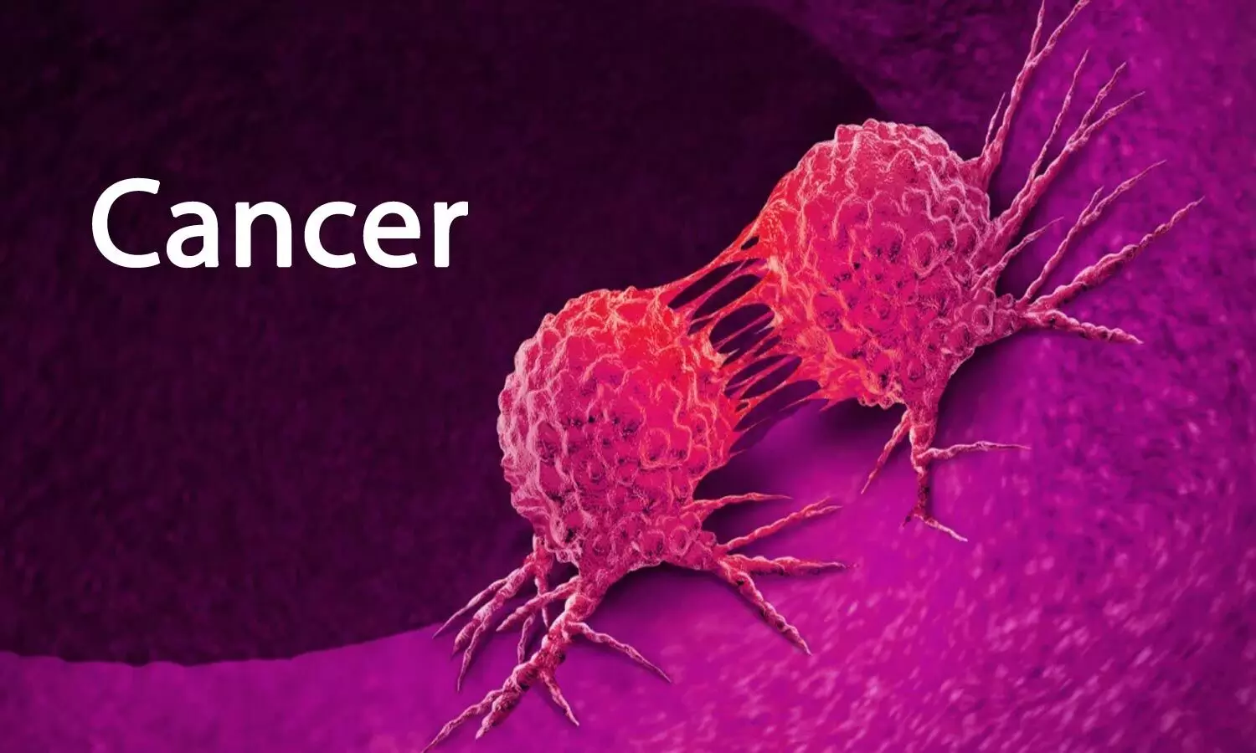
1 . Cancers
Cancer is a disease in which some of the body's cells grow uncontrollably and spread to other parts of the body.
Cancer is becoming more prevalent in Sri Lanka.
In 2019 - 31484 total cancer cases in Sri Lanka
14854 of them are male and 16994 were female (National Cancer Control Program)
Madusanka G.K.I (IT21189944)
11

Slide 12
most common cancers in Sri Lanka
Breast
Oral Cavity
Esophagus
Cervix
Lungs
Thyroid
Colon & rectum
Lymphoma
Ovary
Leukemia
Madusanka G.K.I (IT21189944)
12

Slide 13
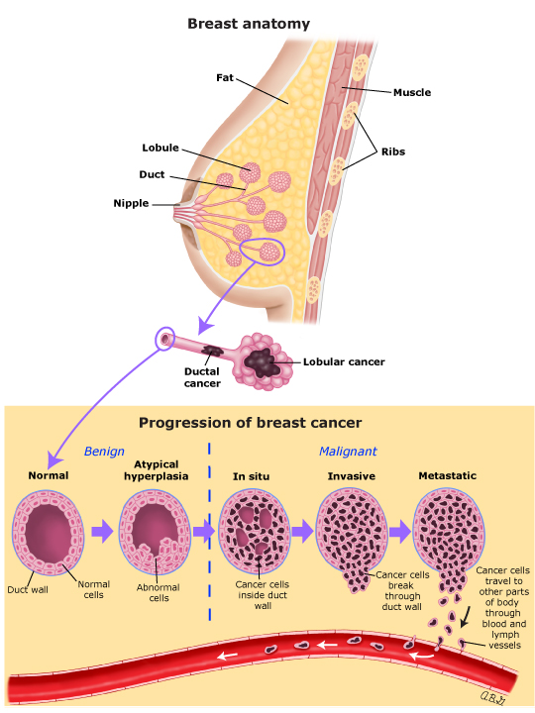
Breast Cancers are the most common cancer in Sri Lanka
Breast cancer deaths in Sri Lanka reached 1,249 in 2018, accounting for 0.98% of all deaths. (WHO)
Madusanka G.K.I (IT21189944)
13

Slide 14
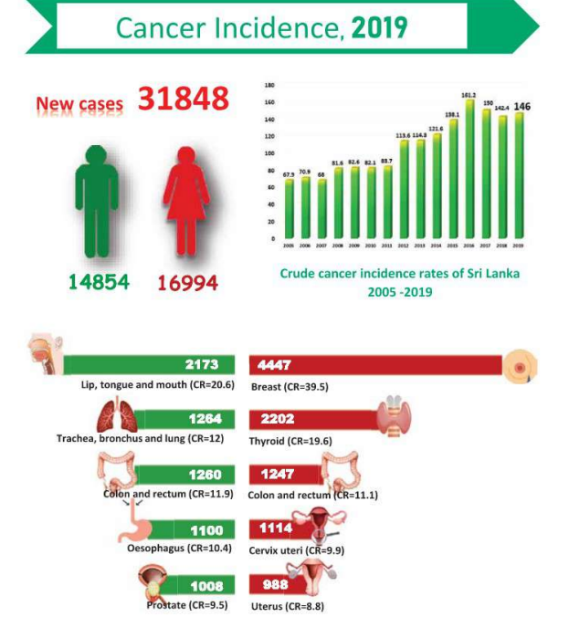
Breast cancers are popular among female patients and Lip, tongue, mouth cancers are popular among male patients. (National Cancer Control)
Madusanka G.K.I (IT21189944)
14

Slide 15
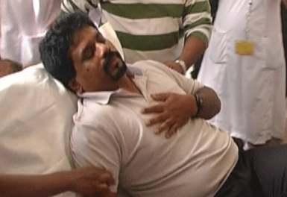
1 . Heart Diseases
Heart disease is a collection of diseases and conditions that cause cardiovascular problems.
The shortage of blood supply to the heart muscle is a primary cause of coronary heart disease.
The condition becomes more common as people get older
Madusanka G.K.I (IT21189944)
15

Slide 16
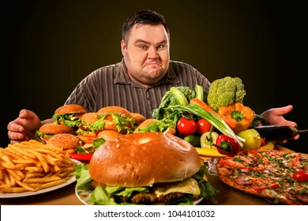
2. Common Reasons for NCDs
Thisera W.N.M (IT21190216)
16

Slide 17
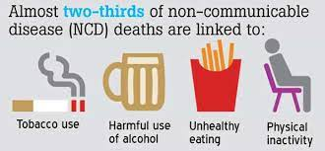
Main reasons
Use of tobacco
Physical inactivity
Harmful use of alcohol
Unhealthy diet
Thisera W.N.M (IT21190216)
17

Slide 18
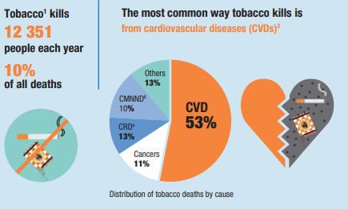
1. Use of tobacco
around one-fourth(28.8%) of adults were current users of some form of tobacco.
Heart diseases and stroke are the commonest ways by which tobacco kills people.
Thisera W.N.M (IT21190216)
18

Slide 19
2. Physical inactivity
average amount of physical activity is a protective factor against many non- communicable diseases.
females (30%) are significantly inactive compared to males (19%).
This problem may increase coronary heart disease (CHD),type 2 diabetes and shortens.
Thisera W.N.M (IT21190216)
19

Slide 20
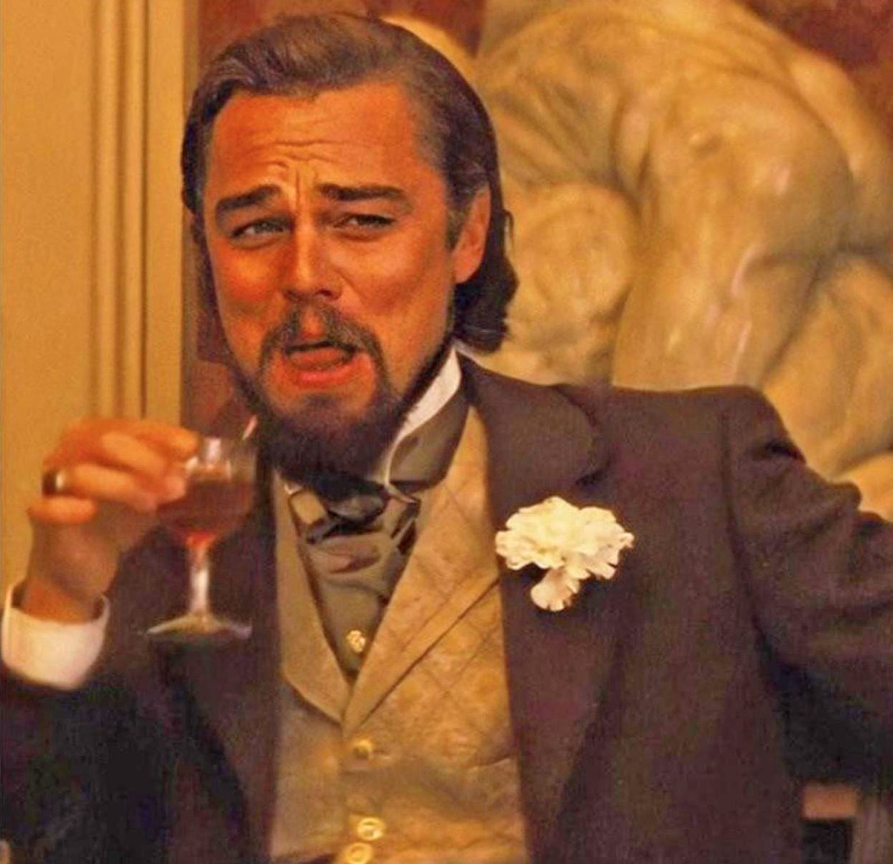
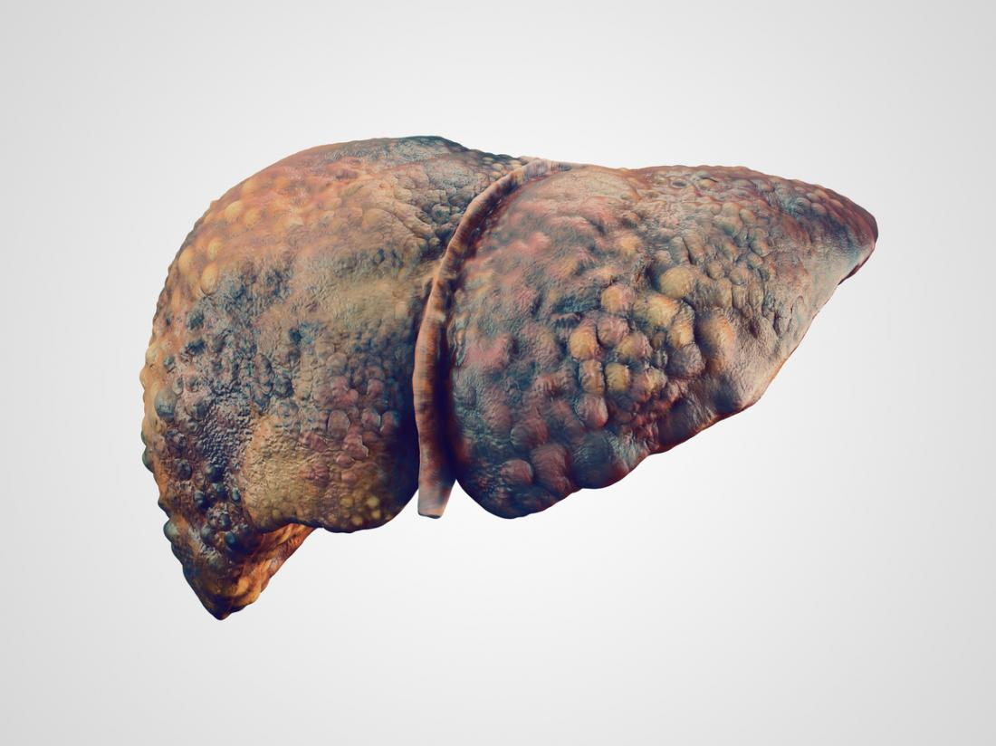
3. Harmful use of alcohol
alcohol cause for non- communicable diseases and social consequences as well. (WHO)
Cause to more than 10% of the load of NCD’s.
Also Cause to cirrhosis of the liver , pancreatitis , cancers
Thisera W.N.M (IT21190216)
20

Slide 21
4. Unhealthy diet
Unhealthy diet is unhealthy foods which are not suitable for human health.
82% of adult do not include adequate number of vegetables to their daily diet
saturated fat and unsaturated fat is a major risk fact for the cholesterol, cardiovascular diseases
Thisera W.N.M (IT21190216)
21

Slide 22
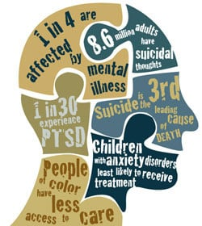
3. Psychological
Effect of NCDs
Rajapaksha C. S - IT21377280
22

Slide 23
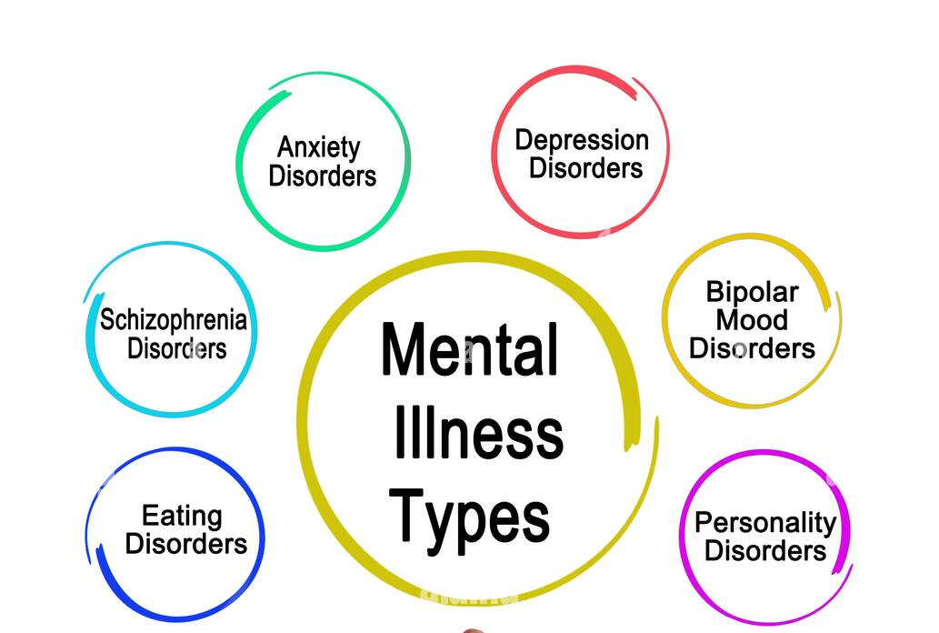
Mental health conditions are one of the major groups of noncommunicable diseases.
Psychological diseases
Depression
Bipolar disorder
Schizophrenia
Psychoses
Dementia
Developmental disorders including autism
Rajapaksha C. S - IT21377280
23

Slide 24

Common mental disorder is Depression.
264 million people are affected in world. (WHO)
Rajapaksha C. S - IT21377280
24

Slide 25
Effects of psychological diseases
Excessive fears or worries, or extreme feelings of guilt
Extreme mood changes of highs and lows
Stay in away from friends and activities
Significant tiredness, low energy or problems sleeping
Excessive anger, hostility, or violence Suicidal thinking
Suiciding is the most dangerous resulting action of these diseases.
Rajapaksha C. S - IT21377280
25

Slide 26
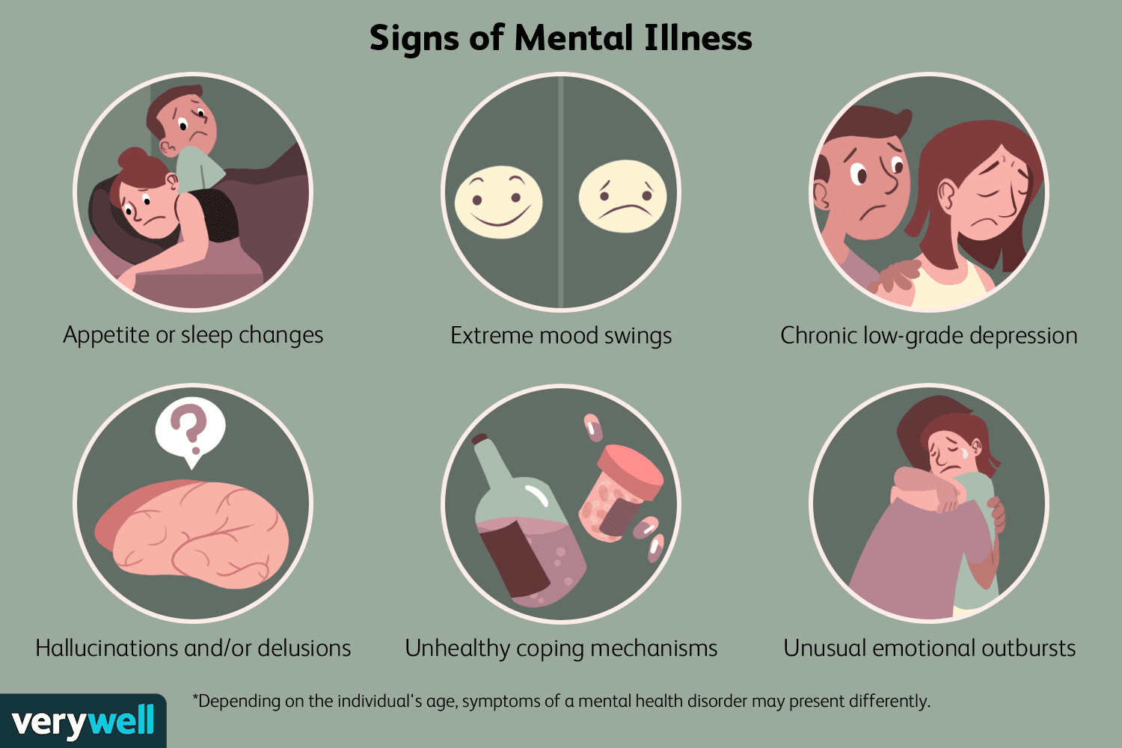
Rajapaksha C. S - IT21377280
26

Slide 27
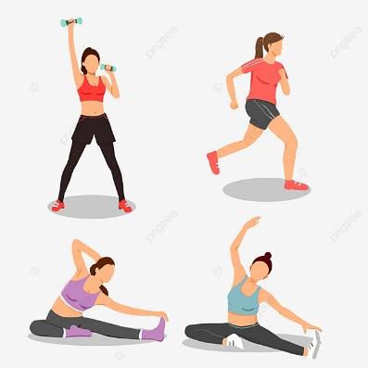


Ways of combating psychological diseases
Stay connected.
Talk about your feelings.
Go outside and travel.
Get a good night’s sleep.
Eat well.
Limit Your Time on social media & The News
Rajapaksha C. S - IT21377280
27

Slide 28
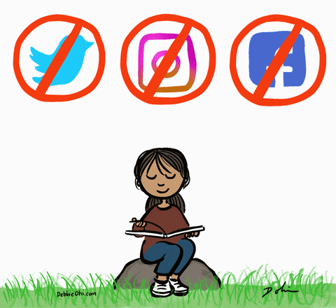
Stay active.
Read books.
Listen to music.
Care for others.
letting go of old grudges or volunteering.
Channel the one doctor for mental illness.
Rajapaksha C. S - IT21377280
28

Slide 29
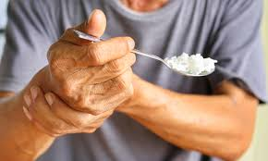
4. Ways of fight against NCDs
Hettiarachchi V. E (IT21379956)
29

Slide 30
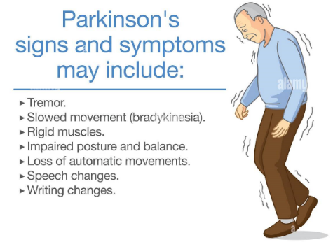
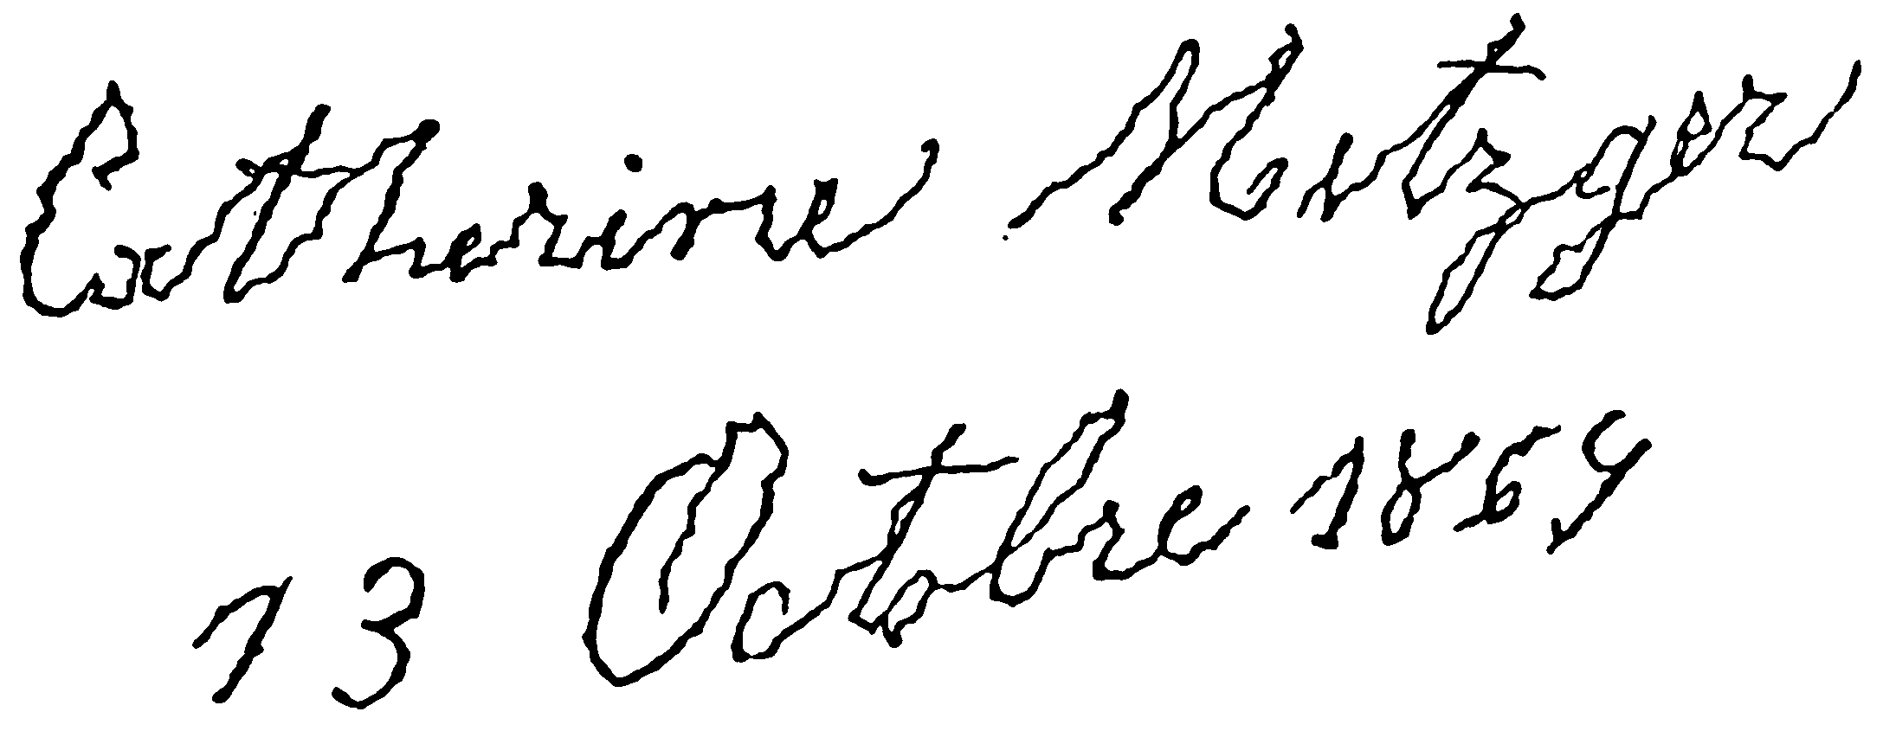
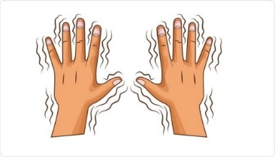
Parkinson’s Disease
long-term degenerative disorder of the central nervous system that mainly affects the motor systems.
How to combat
Aerobic exercises
physical therapies
Speech-language pathologist.
30
Hettiarachchi V. E (IT21379956)

Slide 31
Diabetes’s Disease
Diabetes disease occur when your blood glucose/ blood sugar level is high.
Symptoms- Urinate frequently, thirsty, loss of weight, feeling tired, skin get dry, blurry vision, hungry and numb on hands and legs.
How to combat
Effective exercise
Eat low fat and sodium diet
Avoid smoking and use of alcohol.
Hettiarachchi V. E (IT21379956)
31

Slide 32
Cancer Disease
when some body cells grow uncontrollably and spread to other parts of the body.
Symptoms- Fatigue, Fever, change in the skin, Unusual bleeding, cough, sores that do not heal, weight loss.
How to combat
Engage in regular exercise surgery of removing cancer
Chemotherapy
Radiation therapy
bone marrow transplant
Immunotherapy
Hettiarachchi V. E (IT21379956)

Slide 33
Actions should take to prevent from non- communicable disease.
Avoid Smoking.
Avoid or Moderate use of Alcohol.
Exercise more.
Eat healthy food.
Regularly check Blood Pressure.
Maintain a healthy weight. Good BMI.
Get Proper sleep Regularly.
Sustain Good social life.
Regulate sugar and salt intake
Manage stress.
Hettiarachchi V. E (IT21379956)
33

Slide 34
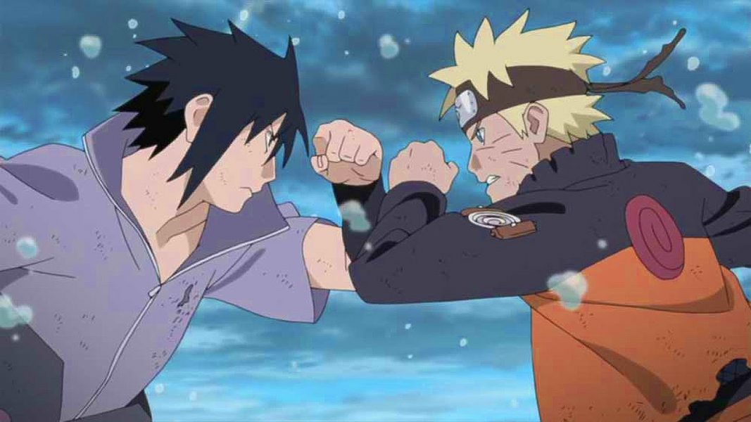
5. Government Actions to fight against non-communicable diseases in Sri Lanka
NCDs
Humans
Hewavitharana D. L (IT21189630)
34

Slide 35
Government actions to fight against
non-communicable diseases in Sri Lanka
1. National policy and strategic framework for prevent and control non-communicable diseases.
2. Actions for reduce harmful use of alcohol.
3. Actions for reduce tobacco use.
Hewavitharana D. L (IT21189630)
35

Slide 36
1. National policy and strategic framework for prevent & control NCD
Awareness.
Counselling.
Create environments that encourage healthy lifestyle.
Hewavitharana D. L (IT21189630)
36

Slide 37
2. Actions for reduce harmful use of alcohol
Marketing policy
Pricing trade and investment policies
Drink driving policies and countermeasures
Community action
Availability and accessibility of alcohol products
Hewavitharana D. L (IT21189630)
37

Slide 38
3. Actions for reduce tobacco use
NATA act prohibits,
Sell tobacco products to person below 21 years of age.
Free distribution , promotion or advertisements related to tobacco products.
Installation of vending machines for tobacco products.
Smoking in public places.
Hewavitharana D. L (IT21189630)
38

Slide 39

Conclusion
Non – communicable disease are spreading all over the world day by day.
Sri Lanka is experiencing an NCD epidemic, with substantial death and morbidity.
Major causes to these NCDs are physical inactivity, harmful use of alcohol and tobacco, and unhealthy diet.
According to these habits NCDs are speeding in all over the world more than other diseases.
NCDs have a physical impact of human life cycle as well as psychological effect.
Regular exercises, prevent using tobacco and alcohol and healthy diet help to prevent NCDs.
39

Slide 40

Our Group Members
Madusanka G.K.I – IT21189944
Thisera W.N.M - IT21190216
Hettiarachchi V. E - IT21379956
Rajapaksha C. S - IT21377280
Hewavitharana D. L - IT21189630
40

Slide 41
Mayo clinic - "Parkinson's disease - Diagnosis and treatment - Mayo Clinic." 24 Mar. 2022, https://www.mayoclinic.org/diseases-conditions/parkinsons-disease/diagnosis-treatment/drc-20376062
You Must Get Healthy - https://www.youmustgethealthy.com/2021/09/ways-prevent-non-communicable-diseases.html
WHO- “World Health Organization”- "Embassy of Sri Lanka Launches Global Youth Ambassador’s Program Trip ...." https://mfa.gov.lk/embassy-of-sri-lanka-launches-global-youth-ambassadors-program-trip-to-sri-lanka/.
Mental disorders - WHO | World Health Organization - https://www.who.int/news-room/fact-sheets/detail/mental-disorders
"The effects of psychological distress and its interaction ...." https://www.ncbi.nlm.nih.gov/pmc/articles/PMC5959313/.
"Mental illness - Symptoms and causes - Mayo Clinic." 08 Jun. 2019, https://www.mayoclinic.org/diseases-conditions/mental-illness/symptoms-causes/syc-20374968.

Slide 42


Thank You
42

Slide 43

Any Questions?
43

